Slide 1

SWA1, Session 7
Functional Programming

Slide 2
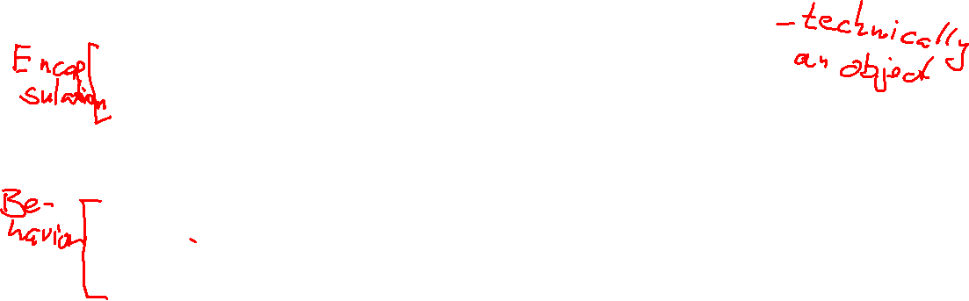
Objects vs "objects"
Object
C struct/Record/Associative array / Data
class Account {
private owner: Customer
private balance: number
constructor(...) { ... }
balance(): number { return balance }
withdraw(...) {...}
deposit(...) {...}
}
const account = {
owner: {
name: "...",
cpr: "..."
},
balance: 234876
}

Slide 3
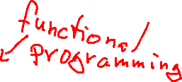
Procedure vs function
Procedure
Function
function printSum(ns: number[]): void {
let sum = 0
for(let n of ns) {
sum += n
}
console.log(sum) }
function sum(ns: number[]): number {
let sum = 0
for(let n of ns) {
sum += n
}
return n }

Slide 4
Functional programming
Object-oriented programming
Functional programming
Data is encapsulated
Data can be mutated (i.e. changed) through well-chosen methods
Methods use changing local variables and loops
Unit tests test objects
A program consists of collaborating objects
A simulation
Difficulty at sub-system boundaries (network, DB)
Regresses to unencapsulated data
Data is freely accessible
Data is immutable
Functions return new data
Functions call other functions or use recursion
Unit tests test functions
A program consists of function calling functions
A computation
Difficulty at system boundaries (GUI, DB)
Regresses to (few) mutable variables

Slide 5

The promise of functional programming
Parallelizable
Testable
Composable
Easier to write correct code
Easier to read (at least to verify that the code is correct)
Shorter

Slide 6
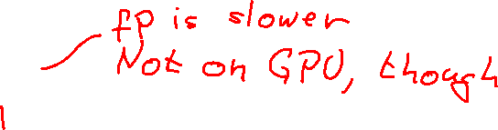
The problem of functional programming
Real life isn’t functional
The problem isn’t functional
The solution isn’t functional
UI
Databases
Network
The CPU isn't functional
Steep learning curve

Slide 7
Pure Functions
Represents a mapping from input to output and nothing else
Mathematical functions
2 Requirements:
Output only depends on input
Doesn’t change the state in any way
Functional programming: All functions are pure
Generally recommended: Only
Procedures
Pure functions

Slide 8

Impure functions
Changes environment
Changes the input
function sum(ns: number[]): number {
let sum = 0
for(let n of ns) {
sum += n
}
console.log(sum)
return sum }
function sum(ns: number[]): number {
let sum = 0
while(ns.length > 0) {
sum += ns[0]
ns.splice(0, 1)
}
return sum }

Slide 9
Pure functions (I)
Imperative style
Functional style
function sum(ns: number[]): number {
let sum = 0
for(let n of ns) {
sum += n
}
return sum }
function sum(ns: number[]): number {
return ns.reduce((sum, n) => sum + n, 0) }

Slide 10
Pure functions (II)
Imperative style
Functional style
function range(to: number): number[] {
const result: number[] = []
for(let i = 0; i < to; i++) {
result.push(i)
}
return result
}
function range(to: number): number[] {
if (to <= 0)
return []
else
return [...range(to - 1), to]
}
// Or
function range(to: number): number[] {
return Array.from(new Array(to), (_, i) => i)
}

Slide 11
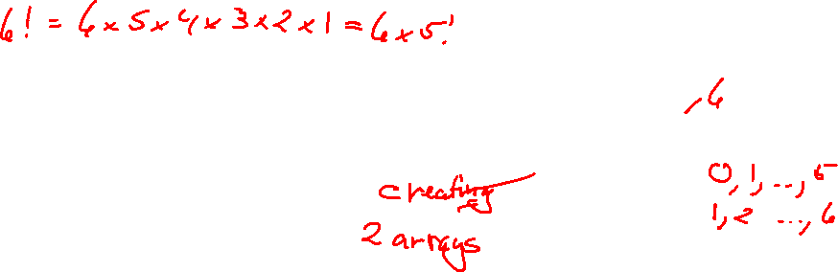
Recursion vs Utility functions
Recursion
Utility functions
function factorial(n: number): number {
if (n === 0)
return 1
else
return n * factorial(n - 1)
}
function factorial(n: number): number {
return range(n)
.map(i => i + 1)
.reduce((fac, i) => fac * i, 1)
}

Slide 12

The function type
The function function F(x: number, y: string): { name: string, age: number} { … }
Has type (x: number, y: string) => { name: string, age: number}
The function const add = (x: number) => (y: number) => x + y
Has type (x: number) => (y: number) => number

Slide 13

Higher-order functions
Definition: A function that
takes a function as an argument
or returns a function as a result (or both)
Use build-in higher-order functions and methods (map, filter, reduce, slice on arrays)
Or: Use lodash, ramda, underscore, immutable.js …
Code: hof.ts

Slide 14
Immutability
TypeScript
JavaScript
type Account = Readonly<
{
owner: Customer
balance: number
}
>
function withdraw(amt: number,
act: Account): Account {
...
}
const account = Object.freeze({
owner: Object.freeze({
name: "...",
cpr: "..."
}),
balance: 234876
})
function withdraw(acc, amt) { ... }

Slide 15

Note the argument order
OO:
account.withdraw(1000)
Traditional functional:
withdraw(1000, account)
Allows this:
const withdraw1000 = withdraw.bind(null, 1000) withdraw1000(account)
We'll use this next week

Slide 16
Immutable objects
A hybrid between OO and functional
Made with classes/objects containing methods
Doesn't mutate the object
Instead returns a new object

Slide 17
Immutable Object
class Account {
private readonly owner: Customer
private readonly balance: number
constructor(...) { ... }
balance(): number { return balance }
withdraw(...): Account {...}
deposit(...): Account {...}
}

Slide 18
Example
mutable.js - classic OO style
immutable.js - immutable object style
functional.js - functional programming

Slide 19
Practical functional programming
Read-only types
Many, small functions
Thinking in pipelines of operations
Libraries to make operations easier (next week)
Step-wise refinement to switch from imperative to functional style
State management
Side-effect management

Slide 20
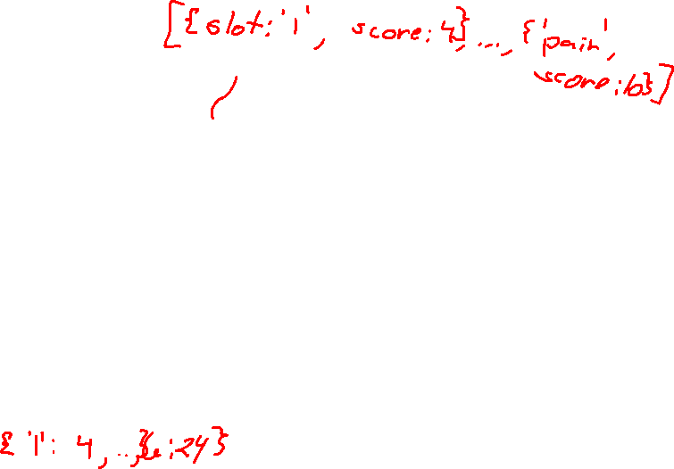
Imperative origin
const scores: any = {}
for(let {slot, score} of player_scores) {
const number_slot = parseInt(slot)
if (isDieValue(number_slot)) {
if (typeof score !== 'number') continue
scores[number_slot] = score
}
}
return scores

Slide 21
Working with arrays
const scores: any = []
for(let {slot, score} of player_scores) {
const number_slot = parseInt(slot)
if (isDieValue(number_slot)) {
if (typeof score !== 'number') continue
scores.push([number_slot, score])
}
}
return Object.fromEntries(scores)

Slide 22
Pre-processing: parseInt
const number_player_scores = player_scores.map(({slot, score}) => ({slot: parseInt(slot), score}))
const scores: any = []
for(let {slot, score} of number_player_scores) {
if (isDieValue(slot)) {
if (typeof score !== 'number') continue
scores.push([slot, score])
}
}
return Object.fromEntries(scores)

Slide 23
Filtering the relevant slots
const number_player_scores = player_scores.map(({slot, score}) => ({slot: parseInt(slot), score}))
const die_value_scores = number_player_scores.filter(s => isDieValue(s.slot))
const scores: any = []
for(let {slot, score} of die_value_scores) {
if (typeof score !== 'number') continue
scores.push([slot, score])
}
return Object.fromEntries(scores)

Slide 24
Filtering out invalid scores
const number_player_scores = player_scores.map(({slot, score}) => ({slot: parseInt(slot), score}))
const die_value_scores = number_player_scores.filter(s => isDieValue(s.slot))
const valid_scores = die_value_scores.filter(s => typeof s.score === 'number')
const scores: any = []
for(let {slot, score} of valid_scores) {
scores.push([slot, score])
}
return Object.fromEntries(scores)

Slide 25
Recognizing the map pattern
function upper_section_scores(player_scores: { slot: string; score: number | null }[]): any {
const number_player_scores = player_scores.map(({slot, score}) => ({slot: parseInt(slot), score}))
const die_value_scores = number_player_scores.filter(score => isDieValue(score.slot))
const valid_scores = die_value_scores.filter(score => typeof score.score === 'number')
const scores = valid_scores.map(({slot, score}) => [slot, score])
return Object.fromEntries(scores)
}

Slide 26
Pipelining
const scores = player_scores
.map(({ slot, score }) => ({ slot: parseInt(slot), score }))
.filter(score => isDieValue(score.slot))
.filter(score => typeof score.score === 'number')
.map(({slot, score}) => [slot, score])
return Object.fromEntries(scores)

Slide 27
State
State exists in (almost) all apps
State is mutable
So:
Have a State type (immutable)
Have a state variable
let state: State = ...
Imagine input (e.g. user input) name, address, email
Make a function to compute new state:
function updateUser(name, address, email, state: State): State
Update state like
state = updateUser(name, address, email, state)

Slide 28
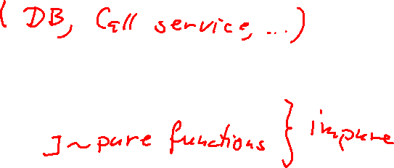
Side-effects
Sandwich model
<read data> <compute functionally> <write resulting data>
Functional dependency injection
f: (impure1, impure2, impure3) => (x, y, z) => result
Code: injection.ts

Slide 29
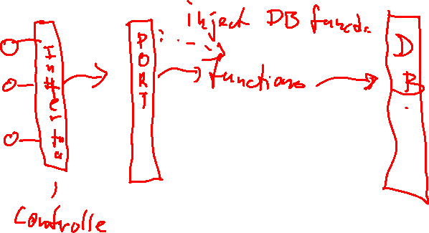
Injection architecture

Slide 30
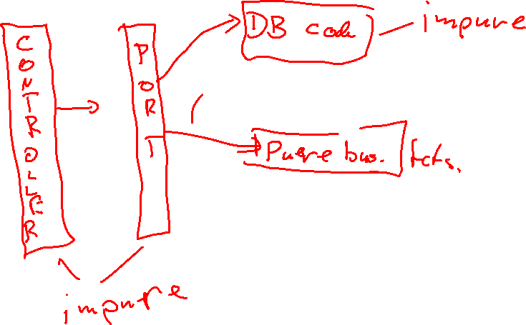
Sandwich Model Architecture

